Slide 1
Trends in Applications to Graduate Management Education in 2022
Application Trends Survey Webinar
November 9th, 2022
Welcome!
The webinar will begin shortly.

Slide 2
Welcome from GMAC
Vision
A world where every talented person can benefit from the best business education for them.
Mission
Provide the tools and information necessary for schools and talent to discover and evaluate each other.
Purpose
To ensure talent never goes undiscovered.

Slide 3
The voices you’re hearing today…
Beth Wickline
Director, Conference & Events
Alexandria Williams
Manager, Survey Research

Slide 4
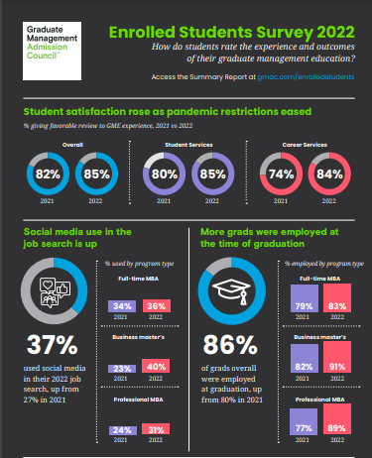
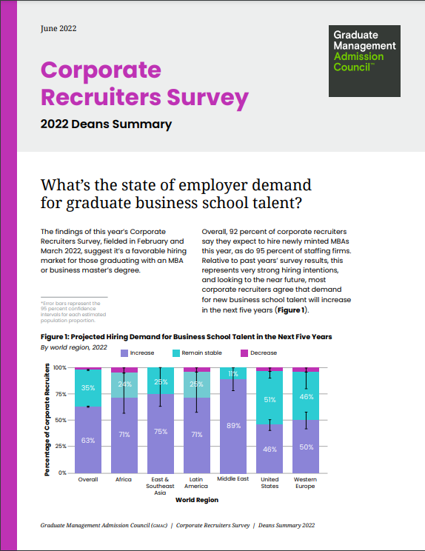
GMAC Research offers reliable data and insights to schools, candidates, and the GME industry
Return on Investment – Candidate’s View
Enrolled Students
Alumni
Value of GME – the Job Market
Corporate Recruiters Survey
Demand for GME
Prospective Students
Application Trends
Geographic Trends
Diversity Series
Learn more about these surveys at gmac.com/research

Slide 5
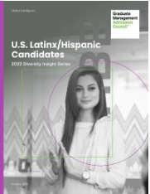
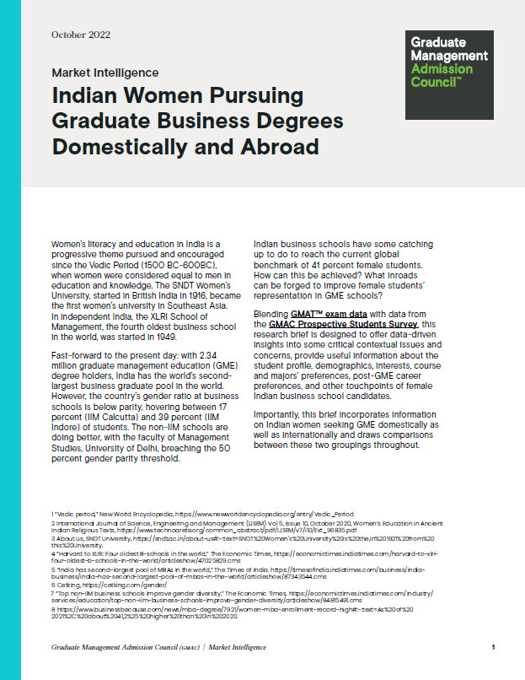
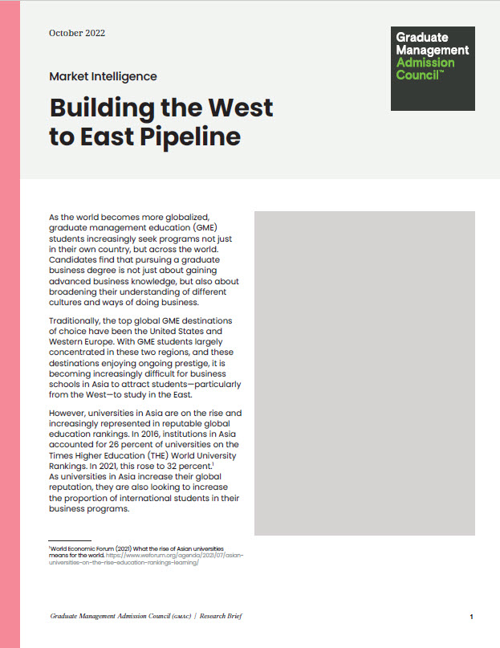
Highlights from 2022 Diversity Insight Series
U.S. Latinx/Hispanic Candidates
Indian Women Pursuing Graduate Business Degrees
Building the West to East Pipeline
Offers insight into the possible factors influencing Latinx and Hispanic American candidates currently in the business school pipeline
Offers insight into female Indian business school candidates, providing context and useful information about their student profile, demographics, interests, course and majors’ preferences, and post-GME career preferences
Offers insight into candidates currently in the business school pipeline from the Americas and Western Europe who are interested in pursuing a degree from a business school in Asia.
blog.gmac.com/gmac-advisor

Slide 6
Agenda
Trends in applications to graduate business programs worldwide
Program type, region, and applicant citizenship
Women candidates
Online programs
Underrepresented populations (URP) in the US
Question & Answer

Slide 7
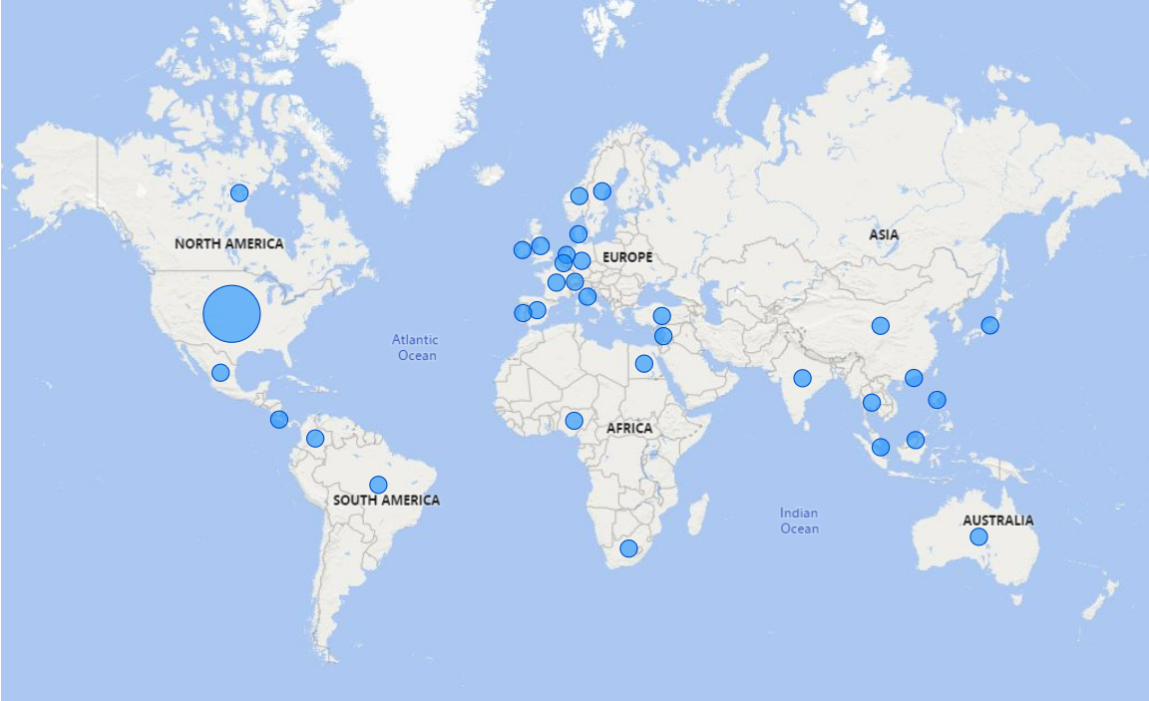
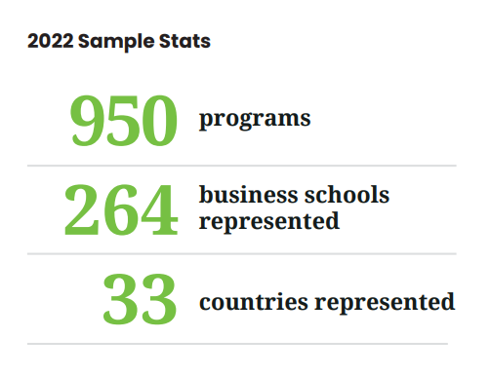
Over 900 programs worldwide participated
in GMAC’s 2022 Application Trends Survey
GMAC (2022). Application Trends Survey.

Slide 8
Global applications to graduate business schools dipped from their pandemic highs
Total applications slipped 3.4 percent year-on-year among a matched sample of programs.
Among the total sample of responding programs, more reported year-on-year application declines than increases (54% vs. 42%).
GMAC (2022). Application Trends Survey.

Slide 9
MBA applications worldwide cool off in the wake of the pandemic
MBA applications slipped 6.5 percent year-on-year among a matched sample of programs.
Among the total sample of responding MBA programs, more reported year-on-year application declines than increases (60% vs. 37%).
GMAC (2022). Application Trends Survey.

Slide 10
Business master’s applications resume year-on-year rise
Applications to business master’s programs rose 3.2 percent year-on-year among a matched sample of programs.
Among the total sample of responding business master’s programs, equal proportions reported year-on-year application increases and declines.
GMAC (2022). Application Trends Survey.

Slide 11
All MBA program types experienced decline in domestic applications in 2022…
GMAC (2022). Application Trends Survey.

Slide 12
…and growth in international MBA applications in 2022
GMAC (2022). Application Trends Survey.

Slide 13
Domestic applications to most Business Master’s program types declined in 2022…
GMAC (2022). Application Trends Survey.

Slide 14
…and growth in international applications to Business Master’s programs in 2022
GMAC (2022). Application Trends Survey.

Slide 15
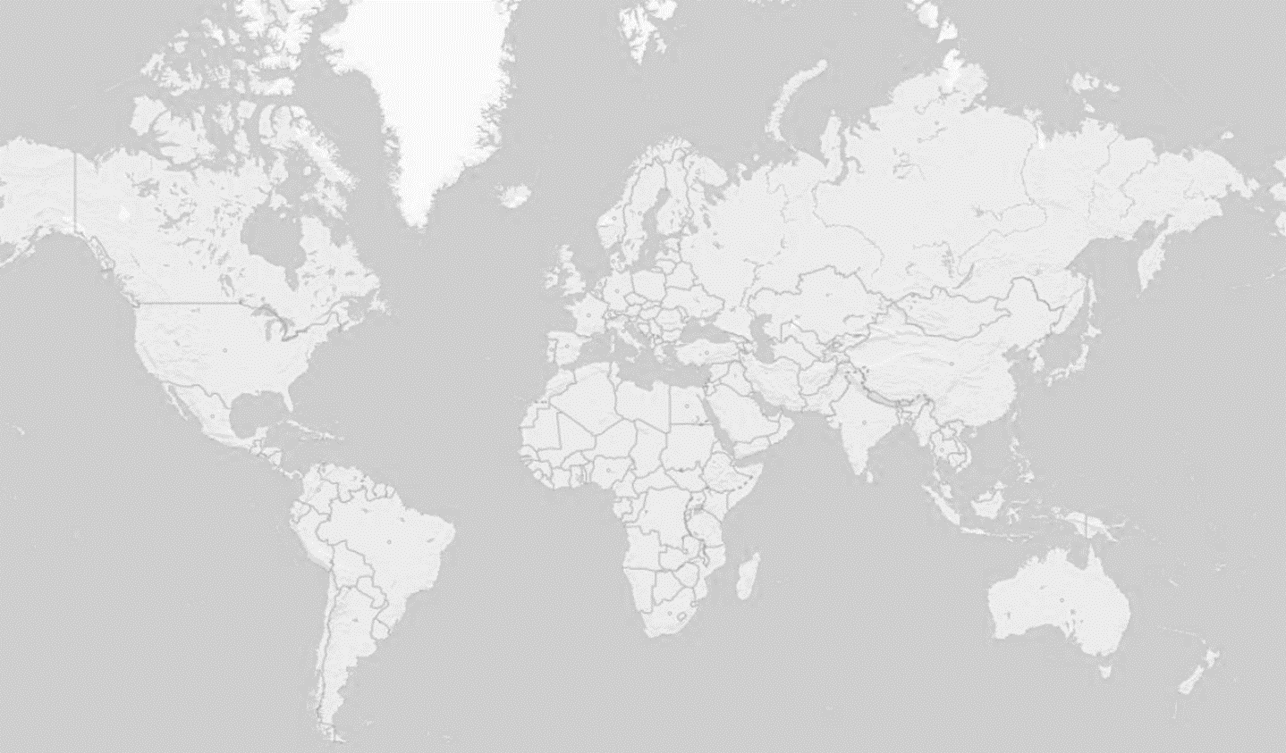
Global trends in international vs. domestic applications
Relative Year-on-Year Change in Domestic & International Applications, by Program Region
I: International
D: Domestic
I
D
I
D
Decline
Growth
Stable
I
D
I
D
I
D
I
D
I
D
I
D
GMAC (2022). Application Trends Survey.

Slide 16
For internationally aspirant candidates, the US and Europe remain top choices…
GMAC (2022). Application Trends Survey.

Slide 17
…and this year more than half of Asia-Pacific programs were up or stable in total apps
GMAC (2022). Application Trends Survey.

Slide 18
In major markets, international applications roared back as domestic demand receded…
United States
Canada
Europe
Greater China
India
GMAC (2022). Application Trends Survey.

Slide 19
Over half of programs in MEA, APAC, Europe grew or maintained women’s representation in applicant pool
Relative Year-on-Year Change in Women’s Applications, by Program Region
74%
Decline
Growth
Stable
47%
53%
67%
69%
75%
45%
47%
GMAC (2022). Application Trends Survey.

Slide 20
Over half of programs in APAC, Europe grew or maintained women’s representation in applicant pool
Relative Year-on-Year Change in Women’s Applications, by Program Region, 2019-2022
Asia-Pacific
GMAC (2022). Application Trends Survey.

Slide 21
Over half of programs in APAC, Europe grew or maintained women’s representation in applicant pool
Relative Year-on-Year Change in Women’s Applications, by Program Region, 2019-2022
Asia-Pacific
Europe
GMAC (2022). Application Trends Survey.

Slide 22
Over half of programs in APAC, Europe grew or maintained women’s representation in applicant pool
Relative Year-on-Year Change in Women’s Applications, by Program Region, 2019-2022
Asia-Pacific
Europe
Canada
United States
GMAC (2022). Application Trends Survey.

Slide 23
Number of new online GME programs outpaces applications to online programs in the U.S.
Trends in the Number of New US Online Graduate Business Programs, 2016-2021
Relative Year-on-Year Change in Total Applications to US Online Programs, 2018-2021
GMAC (2022). Application Trends Survey.

Slide 24
More than half of U.S. programs maintained or grew applications from underrepresented populations
Trends in Applications from Underrepresented Populations to Programs in the US, 2018-2022
Three types of programs with the highest percentage reporting stable or growing applications from underrepresented populations are:
Master of Data Analytics
Master in Management
Flexible MBA
GMAC (2022). Application Trends Survey.

Slide 25
Executive summary
Applications to graduate business programs have dipped back to their pre-pandemic levels
MBA applications have declined but business master’s programs are growing with an international interest
MBA
European programs have reversed the declines in women applications, while Asia-Pacific programs are trending down
Applications to full-time online programs are declining despite the growing number of programs
Applications from underrepresented populations rise for some business masters program types

Slide 26
Question & Answer

Slide 27
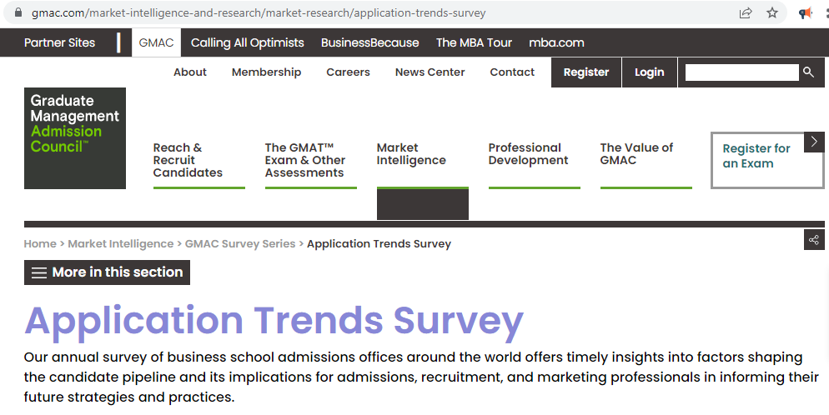
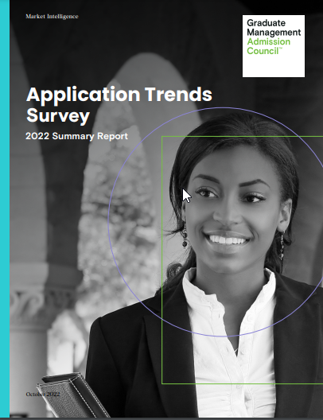
Visit gmac.com/applicationtrends to access the complete report

Slide 28
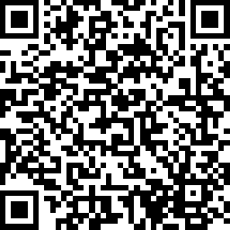
Share your thoughts
Webinar Survey Link
https://www.surveymonkey.com/r/JD5PV22

Slide 29
Thank you!
Sign up for the Connections Newsletter or visit the GMAC Advisor Blog to stay informed on the latest market intelligence and professional development opportunities from GMAC.
Reach out to Research@gmac.com if you have further questions about
GMAC Research & Data Science.

