Slide 1


GRADUATE MANAGEMENT ADMISSION COUNCIL®
Services & Products for Schools

Slide 2

Who We Are
GMAC opens doors for graduate management programs, professionals, and prospective students around the world
The Graduate Management Admission Council® (GMAC®) is the not-for-profit council of the world’s leading business schools.
GMAC owns and administers the GMAT® exam,
the most reliable predictor of academic success
in graduate management programs worldwide.

Slide 3

What We Do
GMAC is the leader in connecting talent and aspiration with opportunity
We believe that business and management are critical to the economic and social well-being of people worldwide.
Our mission is to provide information to improve decision making about the discovery and evaluation of talent for people involved in, or aspiring to be involved in, business or management.

Slide 4

THE GMAT® EXAM
The GMAT exam shines a spotlight on talent around the world
Aspiring graduate management education students in 110 countries take more than 225,000 GMAT exams every year.
The GMAT is the most widely used business and management program assessment tool.
What GMAT scores mean for your school
By accepting GMAT scores, you’re part of a community of programs that are:
Affiliated with quality public and private institutions worldwide.
Consistently included in Top-100 business school rankings.
Made up of all program types – part- and full-time, traditional MBA, executive MBA, and other business and management related master’s degree and PhD programs.

Slide 5

Market Intelligence and Research
GMAC is your reliable source of industry knowledge with surveys, reports, data, and research at your fingertips

Slide 6

Market Intelligence and Research
Your Reliable Source of Industry Knowledge
GMAC survey research and market analysis gives you the tools to make fact-based admissions decisions.
Accepting the GMAT exam gives your school access to a wealth of reliable, robust applicant data, plus reports and research services.
Recruit more precisely and market your programs more effectively because of the insights GMAC derives from GMAT data.
GMAC is committed to helping you increase the pool of viable candidates for your graduate management program.
As part of this commitment, we offer promotional collateral and research publications to GMAT accepting organizations and schools at no charge.

Slide 7
Market Intelligence and Research
Application Trends Survey
mba.com Prospective Students Survey
GMAT Geographic Trends Reports
Global Management Education Graduate Survey
Alumni Perspectives Survey
Corporate Recruiters Survey

Slide 8
Market Intelligence and Research
Benchmark Reports
GMAT® Test Taker Data
Validity Study Service (VSS)

Slide 9
Recruiting Tools
Promote your program and recruit top candidates through a proven portfolio of tools and services

Slide 10
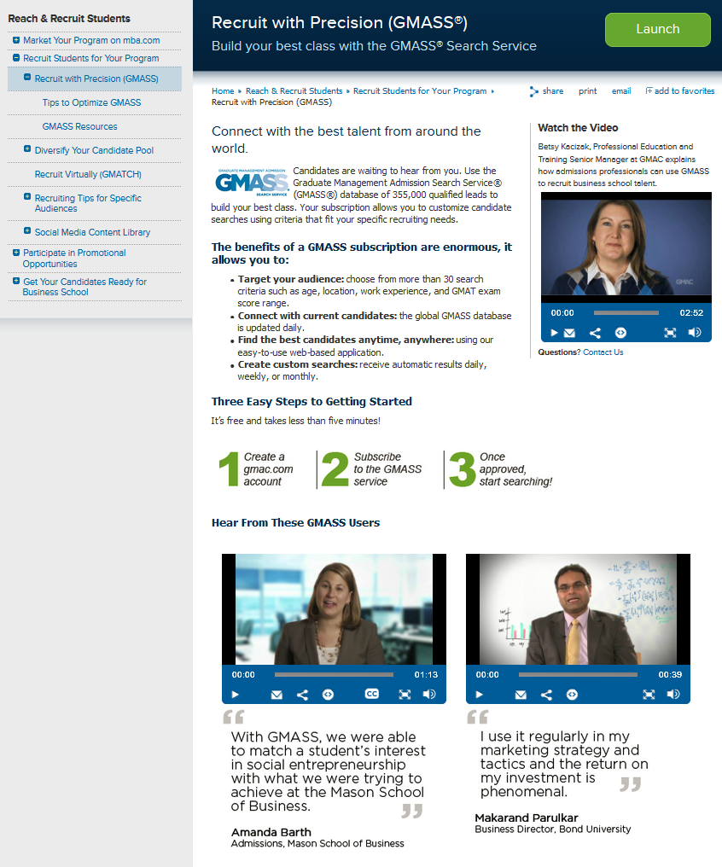
Graduate Management
Admission Search Service®
Connect with the best talent from around the world.
GMASS, powered by a database of nearly 360,000 GMAT and mba.com registrants, lets you find and connect with aspiring who have the qualifications and backgrounds you’re looking for.

Slide 11
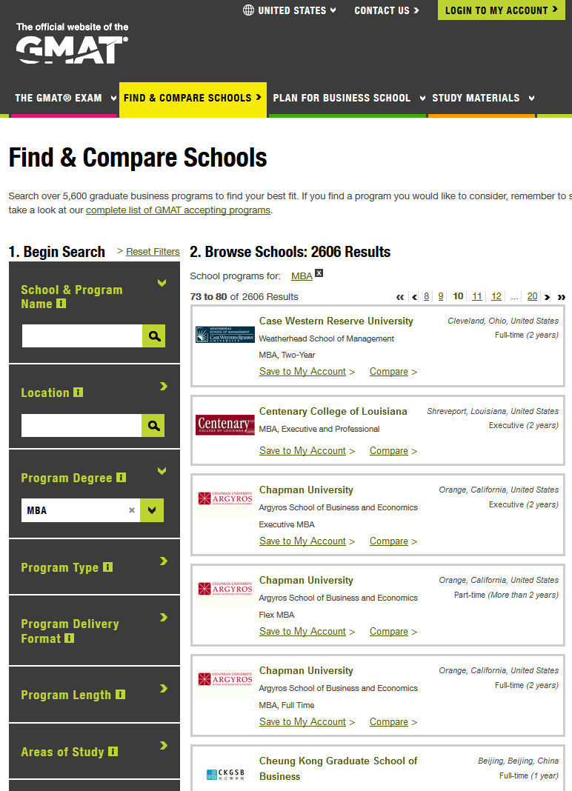
School Finder
Connect your program to more than 450,000 prospective students per month
The mba.com School Finder tool lets students search, view, compare, and connect with you, using our complete listing of GMAT accepting schools and programs.
We create and maintain your program profiles, and you review and update using one simple form.

Slide 12

Calendar of Events
Boost attendance at your recruiting events by promoting them on mba.com
Post recruiting events online so potential candidates can find you 24 hours a day, seven days a week. Free to schools that accept the GMAT exam.

Slide 13

Prepare Your Candidates
GMAC’s assessment and development tools shine a light on talent and skills

Slide 14

Reflect™ by GMAC
Help your students take an active role in bolstering their strong qualities and improving their weaker ones.
Reflect is a soft-skills self-assessment and development tool that gives you a deeper understanding of how your students approach challenges, solve problems, and interact with others.
After an assessment that takes less than one hour, a personalized report is created with actionable tips, resources and benchmarking tools.
Notes:
Add Reflect Logo to top right side

Slide 15

ESSENTIALPrep™
Boost attendance at your recruiting events by promoting them on mba.com
Post recruiting events online so potential candidates can find you 24 hours a day, seven days a week. Free to schools that accept the GMAT exam.
Get your students ready for the classroom with tutorials on statistics, quantitative skills, finance and accounting.
Notes:
Add essential prep logo

Slide 16

CareerLeader®
Gain powerful insights into your skills and passions.
CareerLeader is an interactive, online self-assessment tool that translates powerful insights about your skills and passions into concrete recommendations for business career paths that are right for you.
Users take a series of three online tests, and the answers you provide give you results about our ideal career path.

Slide 17
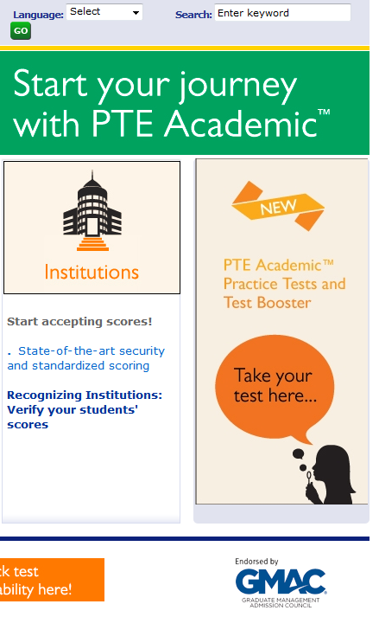

Pearson Test of English
Academic (PTE)
Ensure that your international cohort is equipped to succeed in an English language classroom.
This computer-based test provides a real-life measure of test takers’ English language ability. The test contains authentic material from academic contexts giving you confidence that you are accepting students who can communicate effectively in an academic environment.

Slide 18

GMAT® Prep
Official GMAT study guides
Featuring GMATPrep® Software, are the only products available that use real, retired questions from the GMAT exam.

Slide 19
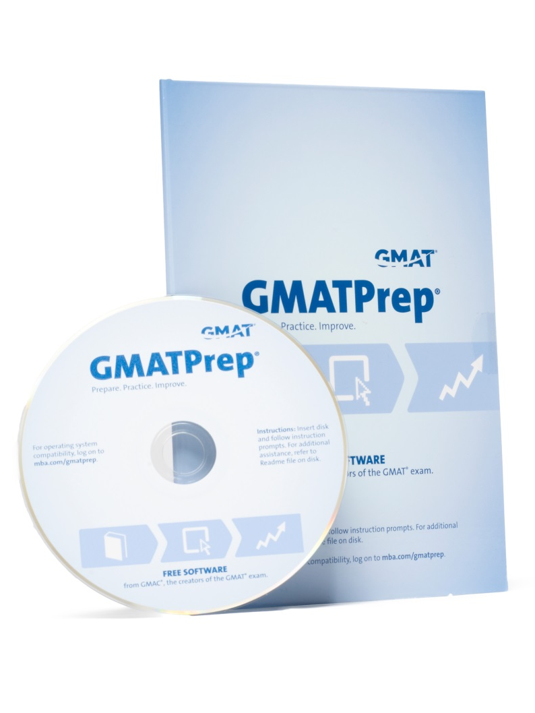
GMATPrep® Software
Free to those who register on mba.com, GMATPrep uses real, retired questions from the GMAT exam and the scoring algorithm used in the actual exam.
Learn about the test, the math skills you'll need and a step-by-step guide to preparing for the GMAT exam.
Try real GMAT exam questions, review your progress and apply what you learned in two full-length exams.
Explore strategies to help you go further, buy more questions and find additional prep tools to meet your needs.
Notes:
Preparation pays off for candidates

Slide 20

Professional Development & Career
Sharpen your skills
Reach your goals, sharpen your skills, and expand your network

Slide 21

GMAC Annual Conference
The premier professional meeting for administrators in graduate management education.
For administrators at all levels who work in admissions, marketing, and program management, the Annual Conference delivers current issues, the latest marketplace trends, research data, best practices, and ample networking opportunities.
Held every June.

Slide 22

GMAC Annual Conference
The premier professional meeting for administrators in graduate management education.
For administrators at all levels who work in admissions, marketing, and program management, the Annual Conference delivers current issues, the latest marketplace trends, research data, best practices, and ample networking opportunities.
Held every June.

Slide 23

Leadership Conference
One of GMAC’s most anticipated events for academic and administrative program directors and program-level deans.
Graduate management professionals from around the world gather in an intimate setting to get the inside track on the state of graduate management education, explore new ideas, and share best practices.
Held in January or February.

Slide 24

Admissions Institute for
New Professionals
For new professionals with six months to two years of experience who want to grow their skills.
An intensive, skills-based program focusing on the core knowledge needed to excel in graduate management admissions.
Held every July.

Slide 25
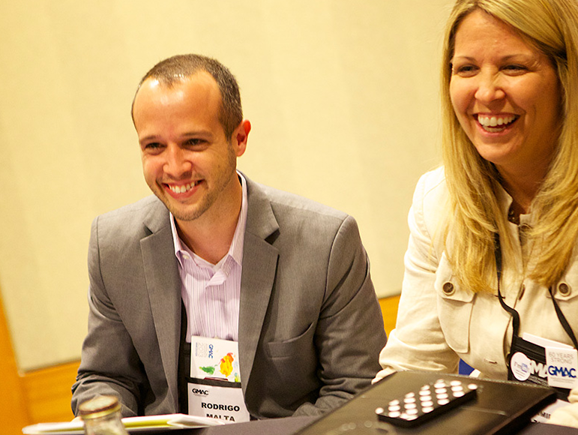
GMAC European Conference
For professionals of all levels with responsibility for admissions, marketing and program direction.
An opportunity to examine in-depth topics of global significance and local interest, as well as strategies and best practices focused on a local perspective. For professionals at all levels with responsibility for admissions, marketing, and program direction.
Held in the fall.

Slide 26

GMAC Asia Pacific Conference
For professionals of all levels with responsibility for admissions, marketing and program direction.
A global forum for exploring issues of critical importance within a growing Asian graduate management education landscape. For professionals at all levels with responsibility for admissions, marketing, and program direction.
Held in the fall.

Slide 27

GMAC Webinars
Stay on the cutting edge of current issues.
From understanding global test-taker trends to using research in your student recruitment messaging to making effective use of GMAC products and services, GMAC webinars offer the latest graduate management education in an accessible format.
Offered online for free year-round.

Slide 28

Learning Library
On-demand collection of professional development opportunities, webinars, and tutorials for all graduate management education professionals.
We know your schedules don’t always align with ours, so we’ve created a resource-rich library of videos from past webinars, webcasts and educational tutorials to complement the numerous in-person events GMAC offers.
Notes:
Need picture of professional not student

Slide 29

Post and Search Job Openings
An up-to-date list of professional positions around the world for GMAT accepting schools.
Explore opportunities in graduate management education and attract the best candidates by directly posting your job openings.
GMAC maintains a current list of professional positions in graduate management education at schools and programs around the world.
Notes:
Photo of professional; not student

Slide 30

Promotional Opportunities
Boost your recruiting by sharing the insights of your admissions staff and students on mba.com
Prospective students identify with stories from their peers and from the insights of admissions professionals.
Admissions professionals from GMAT accepting schools can promote their programs on mba.com, Twitter, blogs, videos, and the Official GMAT Facebook page.

Slide 31

gmac.com
60 years of helping schools recruit, assess, and develop students

