Slide 1

Understanding and Preparing for the GMAT® Exam
Presenter Name
Graduate Management Admission Council®

Slide 2
GMAC®- Graduate Management Admission Council®
Not-for-profit council of the world’s leading business schools.
Elevates graduate management education with more than a billion media impressions.
Owns and administers the GMAT® exam, the most reliable predictor of academic success.
The leading advocate of graduate management education, serving students, schools, and professionals.
Offers the only test preparation materials that use real, retired questions from the GMAT exam.
Manages mba.com, the Official Website of the GMAT Exam, where test takers register to take the exam, find study tips, and search for programs that fit their needs.

Slide 3







Why the GMAT® Exam?
The GMAT exam shines a spotlight on talent around the world.
Created by business schools to discover and select the best students with the greatest potential to succeed.
Measures the skills that are in demand by today’s employers.
A trusted part of the admissions process of more than 5,800 business and management programs worldwide; available in 110 countries.
    6,000+ programs
    2,000+ schools
    110+ countries
    600+ test centers
% of Schools
Using the GMAT
96%
89%
77%
100%

Slide 4
The GMAT Works for You and for Schools
Reliable, Objective, and Strong Predictor of Academic Success
For 60 years the GMAT exam has been the leader in business school and management program admissions because it works:
  As a reliable and trusted predictor of your potential for success in a program and in the classroom.
  As a means of revealing the skills in demand at schools and in business, especially Integrated Reasoning.
  As a way to help you connect with the right program where you can thrive.
Notes:
The GMAT Exam can take you places. Its been taking the world’s business leaders to the world’s leading business schools for sixty years…
The GMAT exam can take you, first to the school where your skills – as revealed by your exam score – will help you thrive and then as the best first step to launching that career with impact you seek.

Slide 5

Opportunities
Today’s graduate business degrees offer countless opportunities and directions – in any kind of setting, anywhere in the world.

Slide 6
Programs that Use the GMAT to Make Admission Decisions
Program Types
MBA (Full & Part-time)
EMBA
MBA/JD, MBA/MPA, MBA/MSW (Other joint or dual degree program
PhD programs
Masters
Hospitality
Industrial Relations or Org Behavior
International Business
Information Technology or Information Systems
Management
Marketing
Public Administration or Public Policy
Real Estate
Supply Chain Management, Logistics or Operations
Masters
Accounting or Taxation
Economics
Educational Leadership
Engineering Management
Entrepreneurship
Finance
Health Administration or Public Health

Slide 7
Why the GMAT is a Strong Predictor of Academic Success
Applicant
4.00
3.80
3.75
3.70
GMAT Total
3.65
Predicted
Mid-
Program
GPA
+
Other
+
UGPA
?
+
AWA
+
IR
3.45
3.35
3.30
3.25
3.20
0.00
Notes:
Admissions officers want to know that you can handle the academic demands of their program.
When they open a file, they do not know if you will likely have a 4.0 GPA in their program or a 0.0 GPA
By looking at the GMAT scores, they gain a much stronger sense of where you might end up
But, there are always other factors that impact grades – work ethic, personal issues (like debt level, home life, etc), and demands from work that can impact academic performance
But, the bottom line is that the GMAT is the best predictor of academic success and that’s why admissions officers value it (and so should you since it will help ensure you end up in a program that is a good fit for you)

Slide 8
GMAT is Part of a Balanced Admissions Process
GMAT Exam
Admissions Process
  Value to Admissions
    Academic potential
    Compare across all applicants
  Value to Applicants
    Opportunity to stand out
    Opportunity to compensate
    Opens doors (admission, scholarships, etc.)
    Confidence
    Preparation for school
Assesses Other Important Skills
  Leadership skills and potential
  Team skills
  Motivation, creativity, emotional intelligence, interpersonal skills
  Job skills
  Business knowledge
  Subject-specific knowledge
  Spoken English
Notes:
But, the GMAT is just one piece of the puzzle in a balanced admissions process.
As you can see here…
The GMAT helps admissions officers determine your academic potential and can compare you across all applicants
The GMAT can help you by providing you an opportunity to standout in the applicant pool, to compensate for a part of your application that may not be particularly compelling. It can open doors to a school you might not otherwise be admitted to and/or it might help you secure financial support from the school. It should give you the confidence to know that you have ability to handle the academic demands of the program. And, finally, studying for the GMAT helps you prepare for business school. So, a lot of upside.
The admissions process is not all about the GMAT and the GMAT does not measure some very important things admissions officers are looking for in candidates – the intangibles, the soft-skills, etc. – this is why you submit your resume, essays, extracurricular activities, recommendations, and often times have an interview. The school wants to make sure you are a fit both academically and personally and they want to know that you will both contribute and benefit from the business school experience…a balanced approach to admissions ensures this is accomplished.

Slide 9
GMAT Structure
30 minutes
30 minutes
Break
Approx.
4
Hours
Total Score: 200 - 800
75 minutes
75 minutes
Break
Notes:
Alright, so what’s on the GMAT and how does it work?
The GMAT has four sections:
Analytical Writing – a 30 minute section that includes one “Analysis of an Argument” question.
A new section, called Integrated Reasoning – this is a 30 minute section with 12 questions (there is a small break after this section)
Quantitative Reasoning – a 75 minute section with 37 questions (there is a small break after this section)
And finally, Verbal Reasoning – a 75 minute section with 41 questions
The entire exam, with breaks, lasts about 4 hours

Slide 10
GMAT Measures Skills Used in School
Analytical Writing
Analysis of an Argument
Integrated Reasoning
Multi-Source Reasoning
Table Analysis
Graphics Interpretation
Two-Part Analysis
B-School Students are Expected to:
Analyze arguments
Take an informed position
Write clearly and effectively
Integrate different pieces of information to identify
interrelations, make inferences, and draw conclusions
Evaluate a wide-range of data
Determine critical and sufficient data
Synthesize reading
Evaluate arguments
Formulate actions and trade-offs and make decision
Quantitative
Reasoning
Problem-Solving
Data-Sufficiency
Verbal
Reasoning
Reading Comprehension
Critical Reasoning
Sentence Correction
Notes:
And, how does it fit with what students see in b-school?
Read from PPT slide

Slide 11
The GMAT Measures the Skills You Use Every Day
Analysis, synthesis, and evaluation
Analytical Writing
  Ability to explore the complexities of an argument and formulate a constructive critique based on a specific line of thinking
Integrated Reasoning
  Ability to convert data from multiple sources and different formats into relevant information to solve problems
Quantitative Reasoning
  Ability to reason quantitatively, solve quantitative problems and interpret data
Verbal Reasoning
  Ability to draw inferences from written materials, critically evaluate arguments, and correct written material
Notes:
So, what does the GMAT measure…
Read from PPT slide

Slide 12
The GMAT is Tailor Made for You
The GMAT is a Computer Adaptive Test (CAT)
Starts with a middle difficulty item
Correct response = harder item
Incorrect response = easier item
An easier item may = content change
One question at a time
Cannot skip or go back
Every item counts in scoring
Adaptive testing is
More accurate
More efficient
More secure
A better testing experience
Notes:
This kind of CAT – Computer Adaptive Test
If you have not taken a standardized test in a while, this will be new to you…this is not the kind of test you took to get into college and you don’t need a number 2 pencil
Read from PPT slide

Slide 13
How a CAT Test Works
Easy Question Hard
Low Score High

45






First Question Last



Notes:
Here’s an example of how it works.
You start with a middle-difficulty question…you’re nervous and get it wrong, so you get an easier question
You get that question wrong, too, so you get an easier question, you get that one right
You settle down and start getting the questions right over and over again, which moves you into the range you should be where you begin to get one wrong, then one right, then one wrong, etc, until the exam is over
So, the exam allows you to have a rough start…or have a great start because you’re lucky, but eventually, you end up in the range you are supposed to be and your score will reflect that…

Slide 14
Section 1
Analytical Writing Assessment
Analysis of an Issue
30 Minutes

Slide 15
Good communication does not mean that you have to speak in perfectly formed sentences and paragraphs. It isn’t about slickness. Simple and clear go a long way.
John Kotter
Professor of Leadership, Emeritus
Harvard Business School

Slide 16
Analytical Writing Assessment – Analysis of an Argument
Because occupancy rates for campus housing fell during the last academic year, so did housing revenue. To solve the problem, campus housing officials should reduce the number of available housing units, thereby increasing the occupancy rates. Also, to keep students from choosing to live off-campus, housing officials should lower the rents, thereby increasing demand.
Discuss how well reasoned you find this argument. In your discussion be sure to analyze the line of reasoning and use of evidence in the argument. For example, you may need to consider what questionable assumptions underlie the thinking and what alternative explanations or counterexamples might weaken the conclusion. You can discuss what sort of evidence would strengthen or refute the argument, what changes in the argument would make it more logically sound, and what, if anything, would help you better evaluate its conclusion.
Sample
Notes:
Here is a sample question…
Read statement and question…

Slide 17
Section 2
Integrated Reasoning
30 Minutes

Slide 18
Today, mastery of business requires the ability to filter and synthesize information from multiple sources in order to make effective business decisions.
Deans Paul Danos, Tuck School of Business and
David A. Pyke, University of San Diego School of Business Administration
Poets and Quants, May 21, 2012

Slide 19
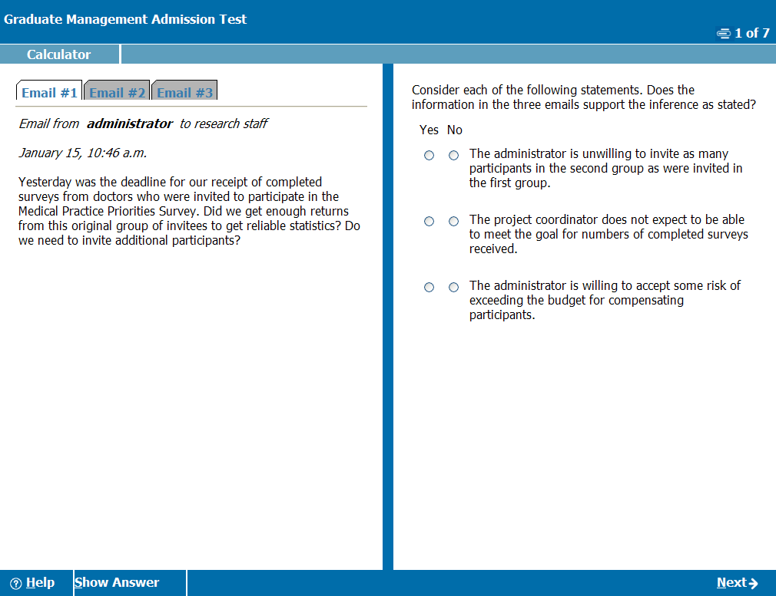
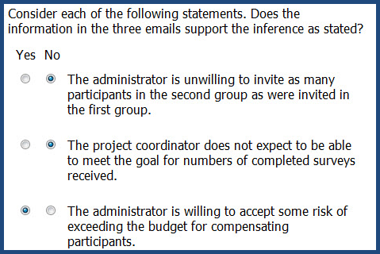
Integrated Reasoning:
Multi-Source Reasoning
Test takers are asked to use text, charts, and/or tables from two to three sources of information to answer questions.
Sample
© 2012 Graduate Management Admission Council® (GMAC®) All rights reserved.
Notes:
A few differences with IR questions…
Use of a on-screen calculator
Ability to click through tabs
May have multiple questions related to the same data / information
Read text in green box…i.e. “Here is a Multi-Source Reasoning question…”
Show answer

Slide 20
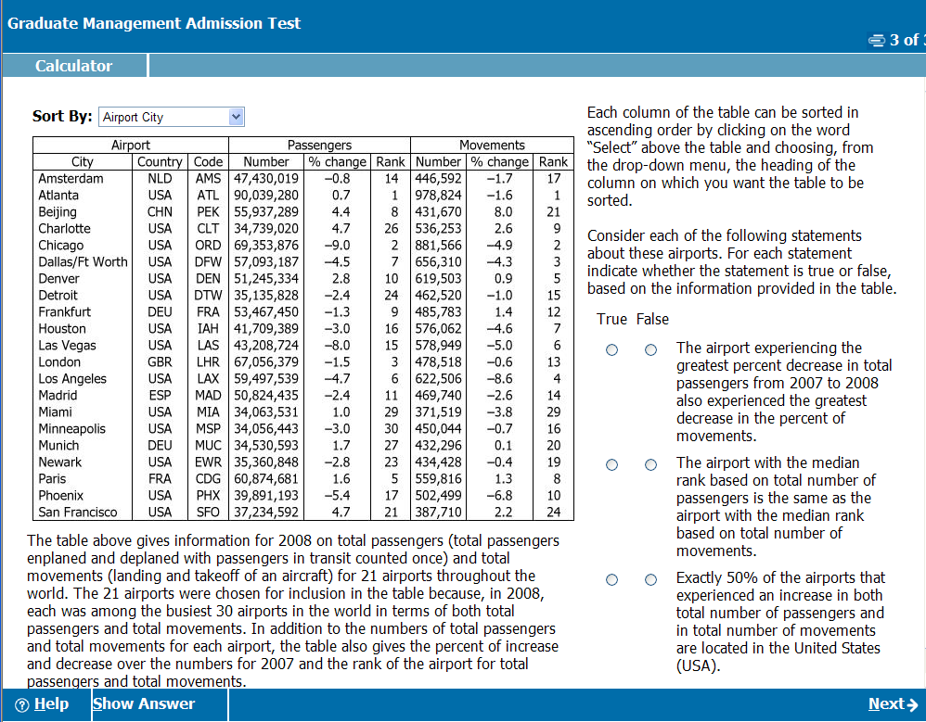
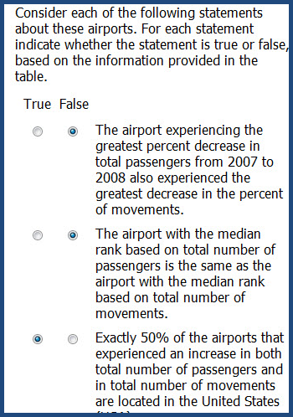
Integrated Reasoning:
Table Analysis
Test takers are presented with a sortable table of information, which has to be analyzed to determine if answer statements are accurate.
Sample
© 2012 Graduate Management Admission Council® (GMAC®) All rights reserved.
Notes:
Read text in green box…”Here is a Table Analysis question…”
You can manipulate the data from the drop-down tool
The text under the table tells you about the table contents
The question is to the right
Show answer

Slide 21
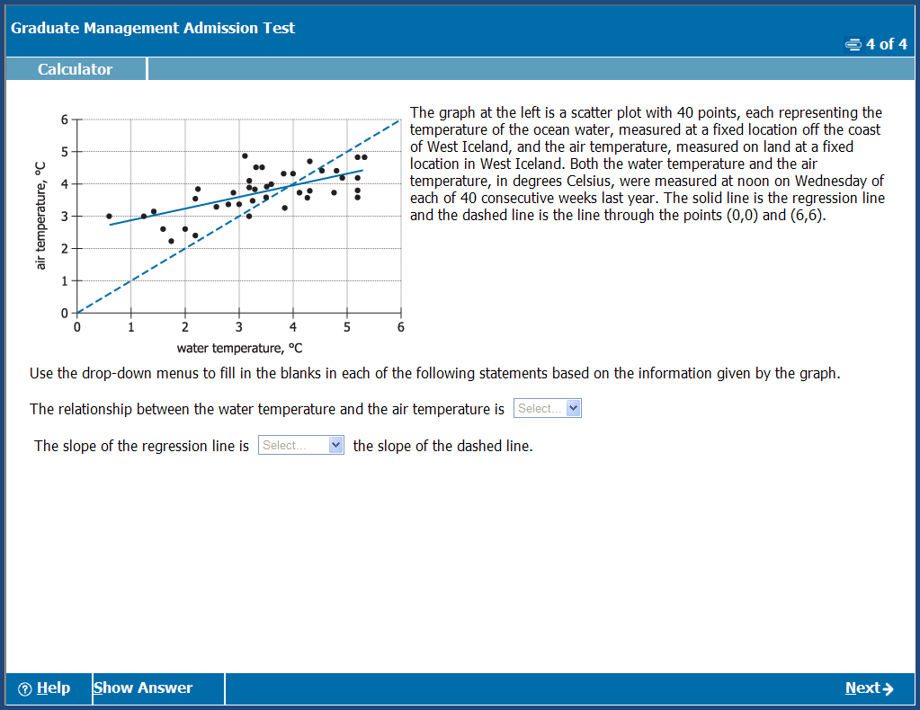
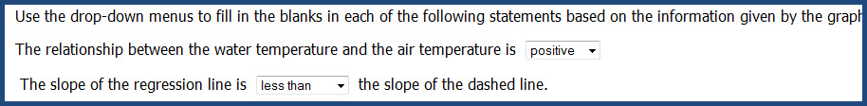
Integrated Reasoning:
Graphics Interpretation
Test takers are asked to interpret a graph or graphical image, and select from a drop-down list to make response statements accurate.
Sample
© 2012 Graduate Management Admission Council® (GMAC®) All rights reserved.
Notes:
Read text in green box “This is a Graphics Interpretation question…”
Here you have a graph, information about the graph to the right, and questions with drop-down lists
Show answer

Slide 22
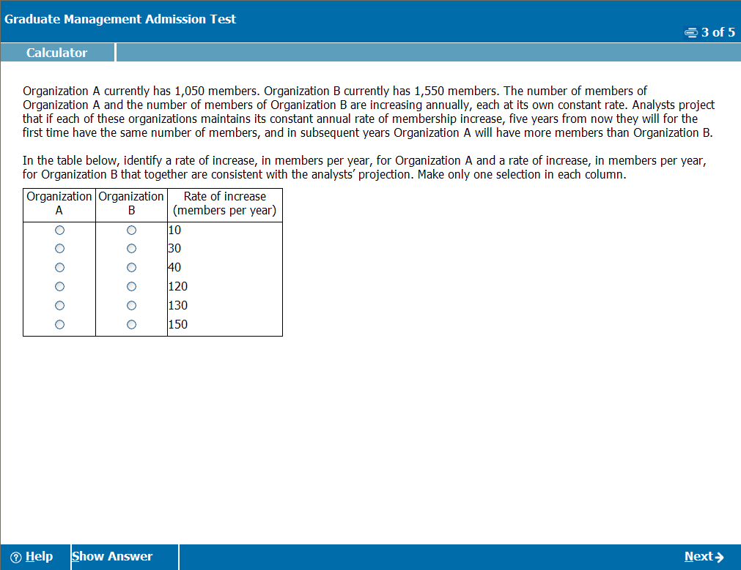
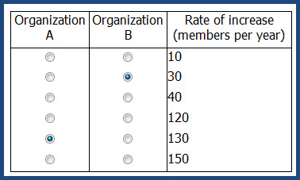
Integrated Reasoning:
Two-Part Analysis
A question will involve two components for a solution. Possible answers will be given in a table format with a column for each component and rows with possible options; test takers are asked to consider the options provided.
Sample
© 2012 Graduate Management Admission Council® (GMAC®) All rights reserved.
Notes:
Read text in green box… “This is a Two-Part Analysis question…”
Show answer

Slide 23
Optional Break
Quantitative Reasoning
75 Minutes
Notes:
You will have an optional break…8 minutes (I believe)
Then you will have the Quantitative Reasoning section – 75 minutes to answer 37 questions

Slide 24
Measure twice, cut once.
Carpenter's Rule

Slide 25
Quantitative Reasoning – Problem Solving
The price of lunch for 15 people was $207.00, including a 15 percent gratuity for service.
What was the average price per person, EXCLUDING the gratuity?
A. $11.73
B. $12.00
C. $13.80
D. $14.00
E. $15.87
Sample
Notes:
Here is a sample of a Problem Solving question…
Read text
Show answer

Slide 26
Quantitative Reasoning – Data Sufficiency
In a certain class, one student is to be selected at random to read. What is the probability that a boy will read?
1. Two-thirds of the students in the class are boys.
2. Ten of the students in the class are girls.
  Statement (1) ALONE is sufficient, but statement (2) alone is not sufficient.
  Statement (2) ALONE is sufficient, but statement (1) is not sufficient.
  BOTH statements TOGETHER are sufficient, but NEITHER statement ALONE is sufficient.
  EACH statement ALONE is sufficient.
  Statements (1) and (2) TOGETHER are not sufficient.
Sample
Notes:
Here is a sample of a Data Sufficiency question…
Read text
All Data Sufficiency questions have the same answer choices…if you can get these down, then you are half way there
Show answer

Slide 27
Optional Break
Verbal Reasoning
75 Minutes
Notes:
You will have an optional break…8 minutes (I believe)
Then you will have the Quantitative Reasoning section – 75 minutes to answer 37 questions

Slide 28
In blog posts, on Facebook statuses, in emails, and on company websites, your words are all you have. They are a projection of you in your physical absence. And, for better or worse, people judge you if you can’t tell the difference between their, there, and they’re.
Kyle Wiens, CEO of iFixit
I Don’t Hire People Who Can’t Write
Harvard Business Review Blog Network
July 20, 2012

Slide 29
Verbal Reasoning – Reading Comprehension
In 1988 services moved ahead of manufacturing as the main product of the United States economy. But what is meant by “services”? Some economists define a service as something that is produced and consumed simultaneously, for example, a haircut. The broader, classical definition is that a service is an intangible something that cannot be touched or stored. Yet electronic utilities can store energy, and computer programmers save information electronically. Thus, the classical definition is hard to sustain.
The United States government’s definition is more practical: services are the residual category that includes everything that is not agriculture or industry. Under the definition, services include activities as diverse as engineering and driving a bus. However, besides lacking a strong conceptual framework, this definition fails to recognize the distinction between service industries and service occupations. It categorizes workers based on their company’s final product rather than on the actual work the employees perform.
Thus, the many service workers employed by manufacturers –
bookkeepers or janitors, for example – would fall under the industrial rather than the services category. Such ambiguities reveal the arbitrariness of this definition and suggest that, although practical for government purposes, it does not accurately reflect the composition of the current United States economy.
The author of the passage is primarily concerned with
A. discussing research data underlying several definitions
B. arguing for the adoption of a particular definition
C. exploring definitions of a concept
D. comparing the advantages of several definitions
E. clarifying some ambiguous definitions
Four additional questions...
Sample
Notes:
Here is a sample Reading Comprehension question…
Show answer
In this case, there will be four other questions related to the text

Slide 30
Verbal Reasoning – Critical Reasoning
A city plans to attract new citizens with new housing and new facilities such as parks, recreation centers, and libraries. One component of the city’s plan is to require that developers seeking permission to build this new housing provide these additional facilities at no cost to the city.
Which of the following, if true, would point to a possible flaw in the city’s plan?
  Light, non-polluting industries have located in the area, offering more jobs and better paying jobs than do the more-established industries in the area.
  Other towns and cities nearby have yet to embark on any comparable plans to attract new citizens.
  Most developers see the extra expense of providing municipal facilities as simply one of the many costs of doing business.
  Developers would pass along their costs to the buyer, thereby raising the cost of housing units beyond the ability of likely purchasers to afford them.
  Studies show that purchasers of new houses, especially first-time buyers, rank recreational resources as an important factor in deciding to buy a particular house.
Sample
Notes:
Here is a sample Critical Reasoning question…
Read text
Show answer
These always seem more like common sense to me

Slide 31
Verbal Reasoning – Sentence Correction
Carnivorous mammals can endure what would otherwise be lethal levels of body heat because they have a heat-exchange network which kept the brain from getting too hot.
  which kept
  that keeps
  which has kept
  that has been keeping
  having kept
Sample
Notes:
Here is a sample of a Sentence Correction question…
Read text
Show answer
So, how did everyone do with the questions in the handout?

Slide 32

Registration, Testing & Test Prep
Understanding the format, practicing sample questions, and reviewing one section at a time will help you arrive fully prepared on the day of your exam.
Notes:
You will have an optional break…8 minutes (I believe)
Then you will have the Quantitative Reasoning section – 75 minutes to answer 37 questions

Slide 33
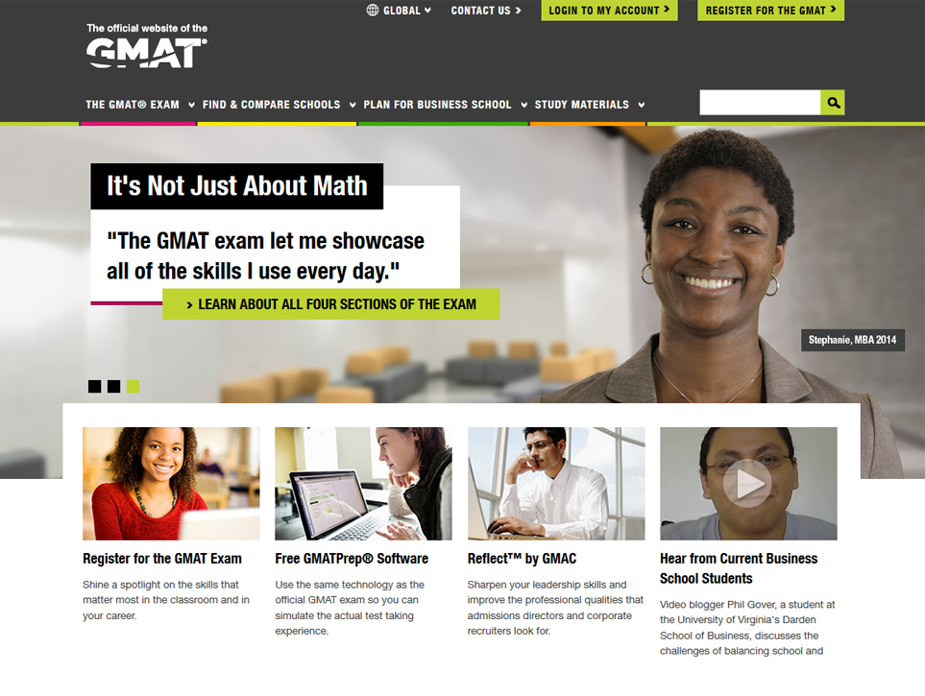

GMAT Registration and Testing
Register at mba.com
You cannot register
at the test center
Secure testing
550+ test centers
110+ countries
Notes:
So, a few logistics…
Register on mba.com
There are a large selection of test centers, so you shouldn’t have any trouble finding one near you

Slide 34


GMAT Costs and Retesting
Cost $250 USD
Includes sending results to five (5) programs FREE
Candidates can retest once a month, up to five times in 12 months
  Twenty percent take the GMAT more than once with an average 30-point gain
Notes:
The GMAT costs $250 – the price hasn’t changed in nearly a decade
You can send your results to have programs FREE
Retesting… about 20% take more than once, generally just one more time. Most retesting did not finish the first time and feel like they can do significantly better (i.e. didn’t study like they should have)
…thus the 30 point jump.

Slide 35
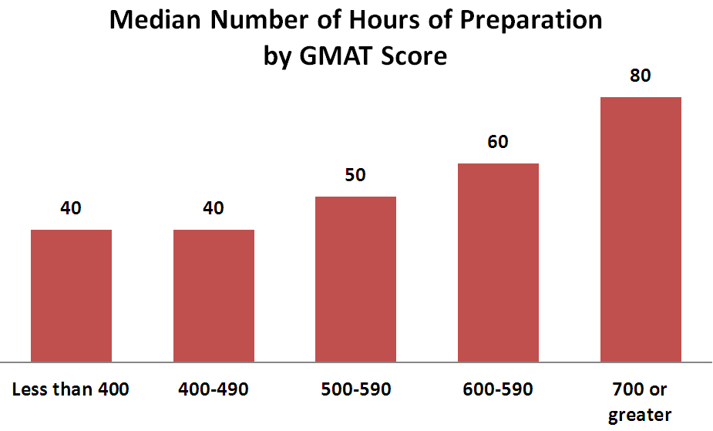
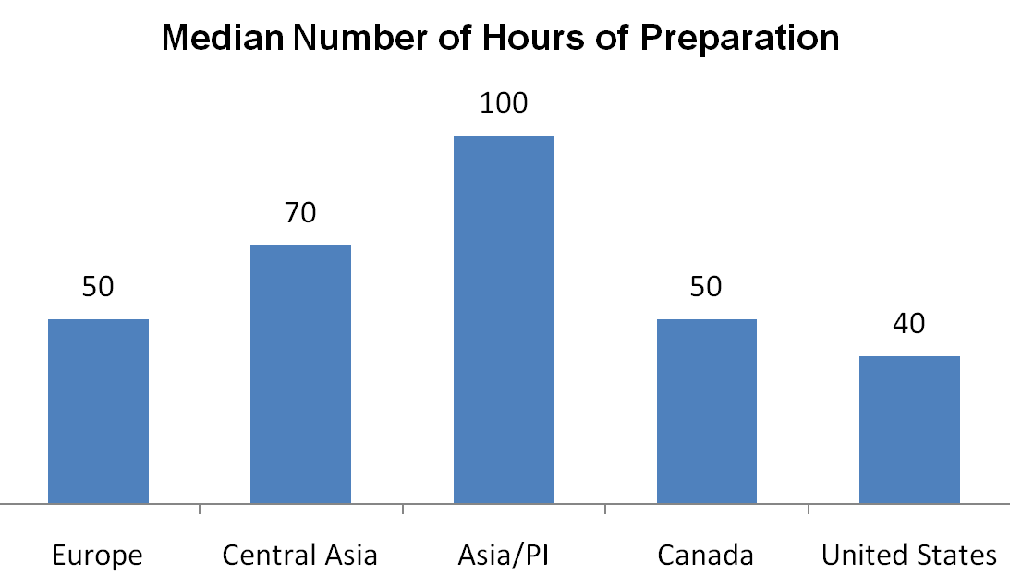
GMAT Preparation – How Much Time?
  Depends on:
  Your discipline to study and your study environment
  Your comfort with the subject matter and item types
  Your need for a GMATPrep program
600-690
SOURCE: mba.com Prospective Students
Notes:
So, how much time is necessary…
Read text
Cultural norms are interesting…in Asia and Central Asia, testing is everything…in the US, test scores are just one component of the admissions process

Slide 36
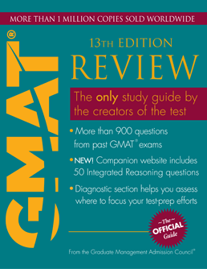
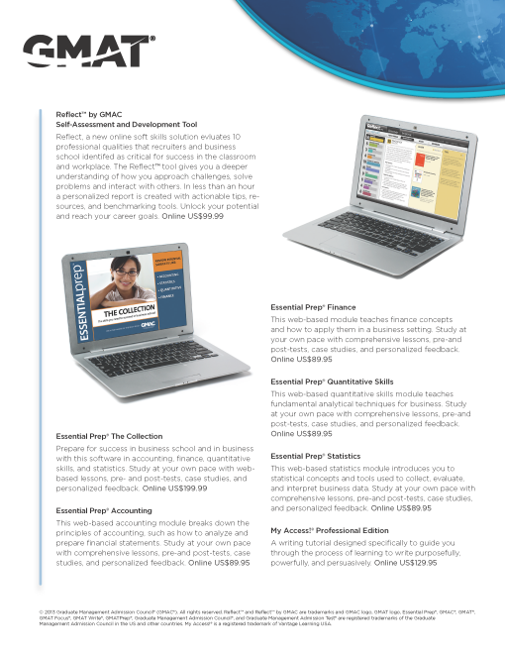
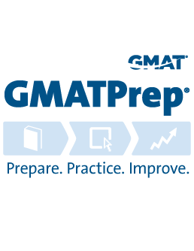
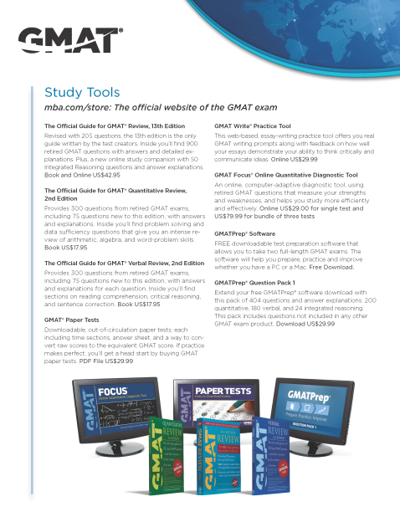
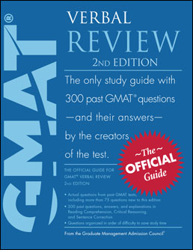


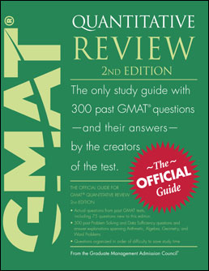

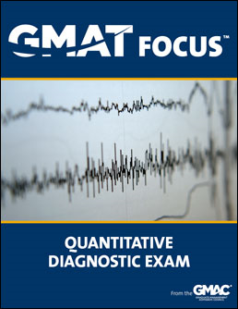
GMAT Preparation – Study Aids
Notes:
Here are the study aids we offer…
GMAT Review is most popular on the market…
If you want more questions, check out the Verbal Review, Quant Review, or buy the extra package of questions available in GMAT Prep.
GMAT write can help you with the AWA section
GMAT Focus is a quantitative diagnostic that will show you which question types you are doing well on or which ones you may need some more practice
All of these are listed on the handout you have
Of special note, GMATPrep is FREE and includes two, full length, computer adaptive tests that are scores. You can also reset the tests to take more tests. In addition, you can pick you own question pack…

Slide 37
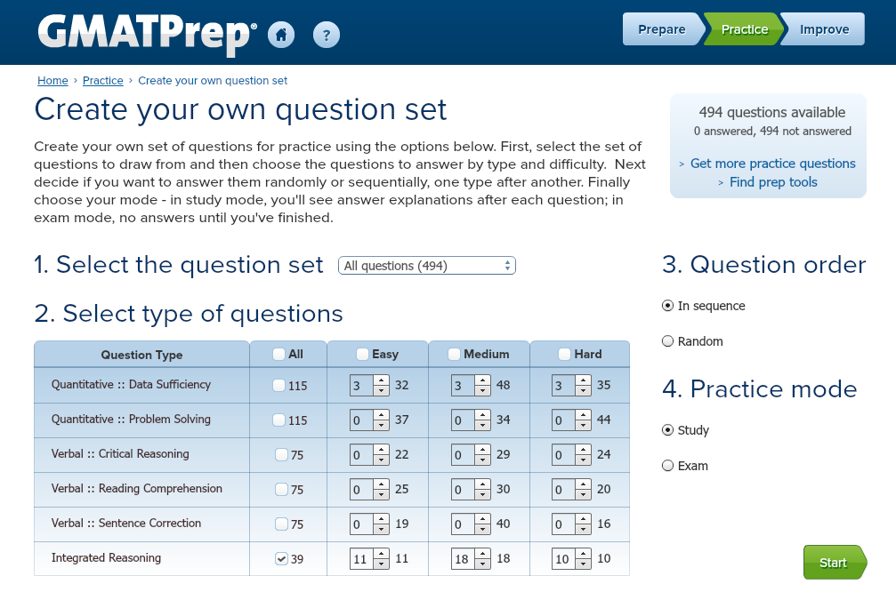
Notes:
You can create a truly custom question set by specifying how many questions of each type and difficulty
For example, on the screen you can see I’ve selected:
A total of 9 Data Sufficiency questions – 3 of each difficulty
All IR questions

Slide 38
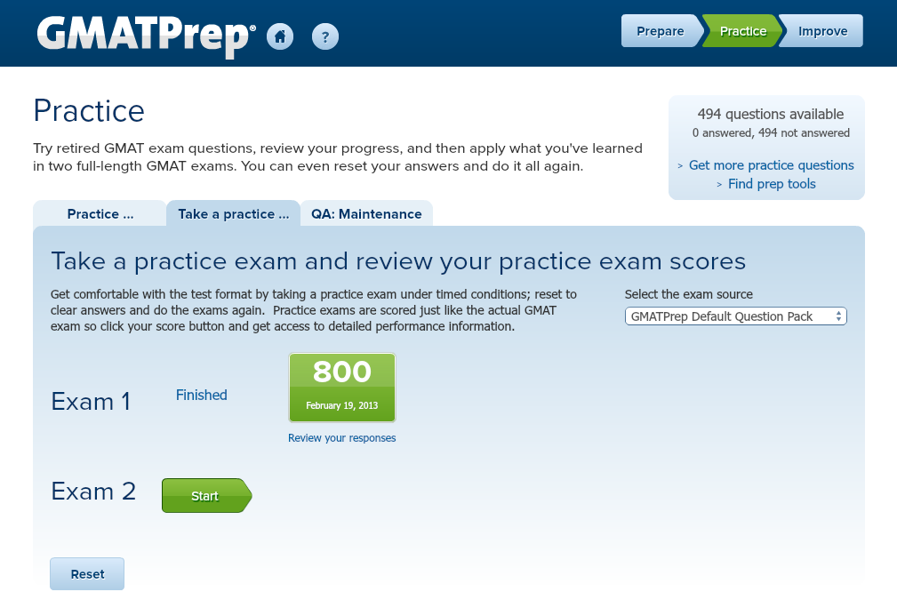
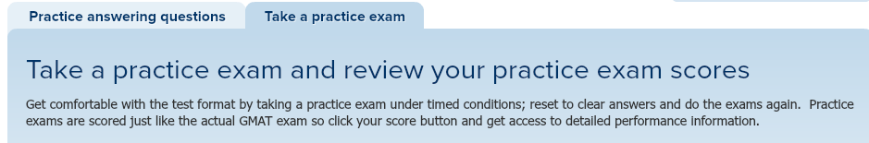
Notes:
And, you can now review your exam responses after completing an exam! Links are provided to the review screens from both this screen and the performance summary tab of their detailed exam results. Once the Reset button is clicked, however, you won’t be able to review your responses to old exams

Slide 39
How You Might Structure Your Prep

Slide 40
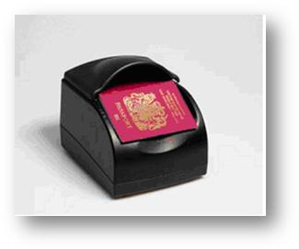
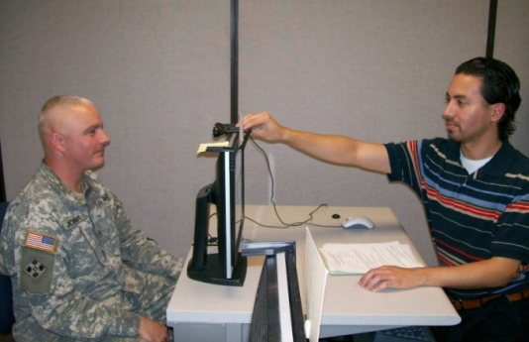

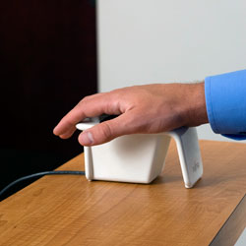
On the Day of Your Exam
Check In
  Valid ID
  Document reader
  Signature
  Digital photo
  Palm Vein recognition
  Use of a locker
Notes:
A few things about test day…
If you know what you’re walking into, you will not be as anxious about it, so...
Since the GMAT is a high-stakes test, security if VERY tight. Taking the GMAT seems to involve more security than boarding and international flight.
You will show a valid ID (drivers license, passport, etc.)
You will provide an electronic signature
You will have a digital photo taken (will be provided to schools)
You will have a palm-vein scan taken
And, finally, don’t cheat…don’t bring your cell phone into the testing room, etc.

Slide 41
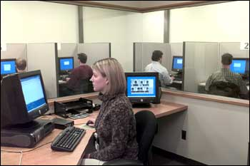

What to Expect Inside the Test Center
Testing
  Individual testing stations
  Proctored
  Use of a note board
  Video
  Choose score recipients
  Score-cancelling option
  Unofficial Score Report
  Official Score Report
  sent within 20 days
Notes:
When you are in the testing room…
You do not bring anything with you…you will have left everything in an individual locked locker in the waiting room
You will have a test station
You’ll use a note board with pen they provide you
There will be a video overhead filming everything
Before you begin the exam, you will choose which programs will receive your results (5 for free, but extras cost $26). If you choose your score recipients afterwards, each will cost $26.
At the end of the exam, you can cancel your exam BEFORE you see your results
If you accept your exam results, you will receive an Unofficial Copy as you check out
Official scores will be sent to you and your score recipients within 20 days, usually faster

Slide 42
Tips, Advice, and Resources on mba.com
Register early: 30 – 60 days before you need to take the exam
Prepare: Helps you do well on the test, in school, and beyond
Take it and bank it: Scores are valid for five years
Download GMATPrep®: It’s free!
Don’t rule a school out: Based on your test score
Believe: In yourself, not the myths. If you develop a plan and stick to it, you’ll succeed.
Like any goal you want to achieve, start with a plan, execute it, and you’ll be fine.
Alok, MBA Class of 2014
The College of William & Mary, Mason School of Business
Notes:
Read text

Slide 43
GMAT Myths
Only the first 10 count
Easy = doing badly
Advance math needed
Accuracy vs. finishing
Need a super high score
Notes:
Read myths…they are all false

Slide 44

Application & Academic Prep
Graduate business schools is a big investment in your future. Careful planning and preparation will help you succeed.

Slide 45

Tips, Advice, and Resources on mba.com
Choosing to get a graduate business degree is a big, exciting decision – and a significant investment in your future.
Visit mba.com to:
Get advice on finding a graduate business program right for you.
Get tips for assembling your best application.
Find recruiting events near you.
Figure out how to finance your degree.
Hit the ground running in your program.

Slide 46


Hit the Ground Running with Reflect
Reflect™ by GMAC
A soft skills development tool to help you identify your strengths, potential derailers, and offer you tools to address them.
Notes:
This is our newest product and it could be a big help to you as a candidate and as a student….

Slide 47
Notes:
Walk them through the demo

Slide 48






Notes:
Great for non-traditionals or people who just have to ‘dust off the cobwebs’

Slide 49

Thank You
The GMAT® Exam
It’s not just the test you take, it’s the test that takes you places.
www.mba.com

