Slide 1

Faculty Collaboration Networks
Owen P. Hall, Jr., P.E., Ph.D.
David M. Smith, Ph.D.
July 26, 2012
5th Annual International Symposium for Emerging Technologies for Online Learning
Sloan Consortium and MERLOT

Slide 2

Agenda
The Challenge
Graduate Management Education
E-Learning
Faculty Adoption
Summary
Notes:
Drucker quote – spin it

Slide 3

The Challenges
Growing business demands
  Web savvy graduates
  Globalization perspectives
Rise of for-profit institutions
Increasing use of the Internet in graduate management education
  Hybrid (Blended)
  Online
Growing educational costs
Stagnate economy
Geographically disperse stakeholders
Notes:
Challenges for Universities in general – collaboration is needed
Challenges that we see from our perspective

Slide 4
Graduate Management Education
Continued debate on leadership versus technical curriculum emphasis
Increased interest in connecting with the business community (e.g., E2B)
Increased demand for fast track and limited residency programs
Renewed focus on customized curriculums
Factors driving these changes include technology, globalization, student demographics, and sustainability
Notes:
We are a graduate business school – context is important
Need for dialogue/collaboration

Slide 5

Graziadio Program Delivery Options
Traditional Face-to-Face
Blended (Hybrid)
Online
Notes:
One size does not fit all

Slide 6

Graziadio Online Program
Borderless education
Limited residency
24-months duration
Comparable curriculum to traditional program
Strong alumni network
Provides flexibility & convenience
Supports sustainability
Notes:
Flexibility and convenience
People are moving into our geographic market

Slide 7
E-Learning
Provides a highly interactive, always connected, content rich, personalized learning systems
Allows a high degree of interaction & collaboration
Supports students
  Time & place
  Customized & personalized
Offers new patterns of relationships between Education and Business
  “Virtual” Internships
  “Virtual” Guest Speakers
  Applied Consulting “Live Case Study” Projects
Notes:
HOW are we going to do this

Slide 8

E-Learning Success Factors
Access, Convenience & Flexibility
Learning Effectiveness
Student Satisfaction
Faculty Satisfaction
Scalability and Sustainability

Slide 9
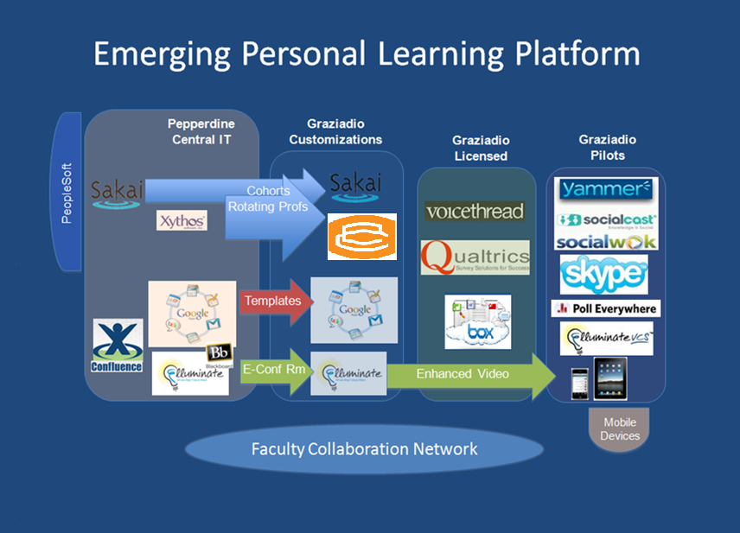

Slide 10
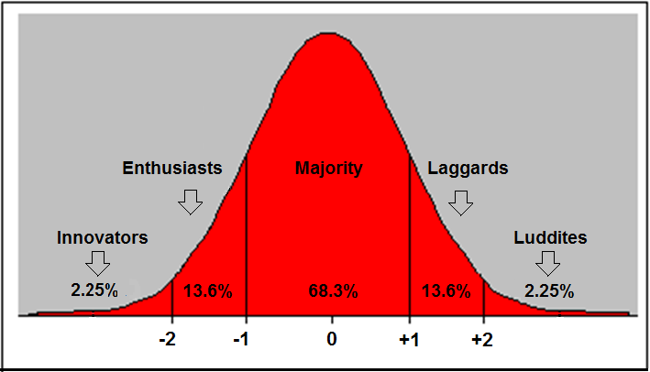
Rogers Technology Adopter Distribution
(Empirical Rule)
Notes:
Hybrid corn in the 1960s – how quickly would the farmers adopt the technology

Slide 11

Faculty Collaboration Networks
The primary goal of a collaboration network is to provide a platform where the management education community can converge, share and exchange ideas to drive innovation in student learning opportunities.

Slide 12

Faculty Collaboration Networks
(Key Characteristics)
Coordination – Ease of use and access
Communication – Capability to share
information
Cooperation – Ability to support group
realization & goals
Notes:
Elluminate example
Distributed faculty
Communication – synchronous and asynchronous

Slide 13

Faculty Collaboration Networks
Faculty
Administration
Students
Business Community
Accrediting Bodies
Researchers
Notes:
Build out of a FCN
Stakeholders who could engage

Slide 14

GMAC Project
Management Education Collaboration Network (MECNET)
The purpose of MECNET is to provide the faculty with the opportunity to converge, share, and exchange ideas to drive innovation in management education
Nine month duration
Primary Deliverable: Requirements and specifications (RFP)
Notes:
GRANT to put together specifications for a FCN

Slide 15
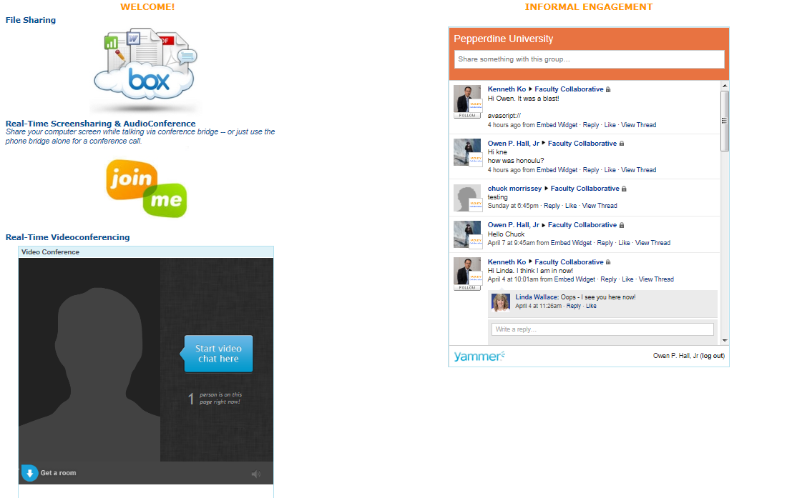
Graziadio Collaboration Network
(Prototype)
Notes:
Videoconference – I’ll believe it is ADOBE

Slide 16
Faculty Attitudes
(N=61)
Internet based technologies can help optimize the costs of teaching and learning
Notes:
We are evolving – majority of the faculty is buying-into an increasing role of internet

Slide 17
Faculty Attitudes
(N=61)
Using on-line learning is not a choice but a necessity
Notes:
Reinforcing message on prior slide

Slide 18
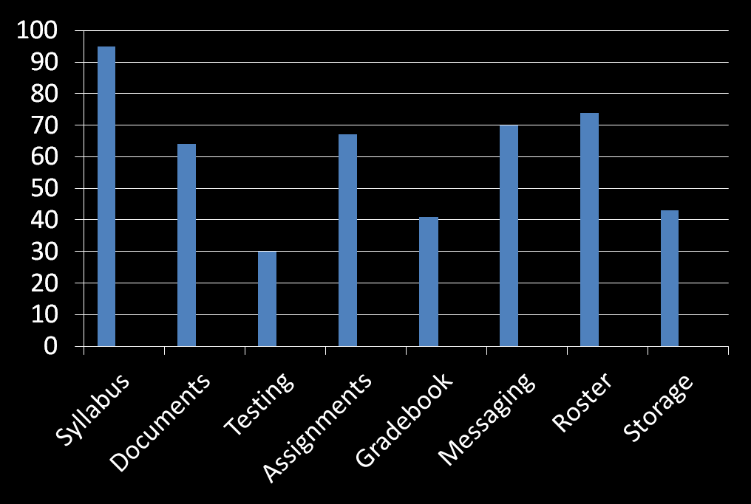
Faculty Attitudes
(N=61)
LMS Usage Patterns
Notes:
Reporting out LMS usage patterns (self-reported)
B-school ahead of other schools on campus

Slide 19
Faculty Attitudes
(N=61)
A Faculty Collaborate Network would be helpful in enhancing Internet usage

Slide 20

What we have learned
Faculty are generally aware of the growing role of the Internet
Sharing via a collaborate network offers a cost-effective vehicle for increasing faculty participation
Technology must be easy to use and navigate
Incentives are useful for encouraging use
Risks must be kept to a minimum
Notes:
Example of incentives: IPAD
Last bullet – needs to work!

Slide 21
Next Steps
Expand faculty training programs
Utilize prototype collaboration network
  Intra disciplinary
  Inter disciplinary
  Between programs
  Between schools
Link network to outside institutions
  B’schools
  Research Institutions
  Accrediting Bodies

Slide 22
Summary
Learning technologies are changing the face of graduate management education
Learning technologies provide content and knowledge at a time and place convenient to the student
Collaboration networks offer a conduit for increasing faculty use of the new learning technologies

Slide 23
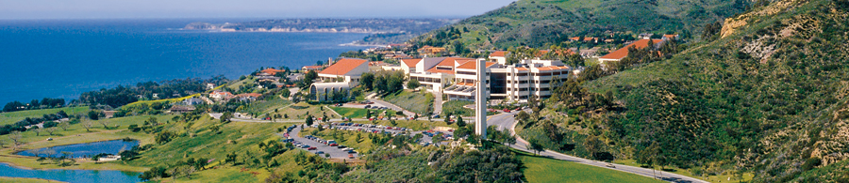

Thanks for Listening!

